Slide 1

About Nikto
Key Features
Flowchart
Process
Nikto

Slide 2
About Nikto:
Nikto is an open-source web server scanner utilized in penetration testing for finding vulnerabilities in websites and web applications. It scans for outdated software, malicious files, misconfigurations and other security issues that can be exploited by attackers.
Nikto is a fast and reliable way to test web servers for known problems, and it's especially good at identifying issues that are not obvious just by visiting the website.
Standards

Slide 3
Key Features
• Vulnerability Detection:
Scans for over 6000 known vulnerabilities like outdated software and insecure files.
• Checks Web Server Configs:
Identifies misconfigurations that can lead to attacks.
• SSL Testing:
Can scan for weak SSL/TLS ciphers and certificate issues.
• Custom Tests:
Supports plugins and test customization for advanced scans.
• Reporting Options:
Exports results in plain text, HTML or CSV formats.

Slide 4
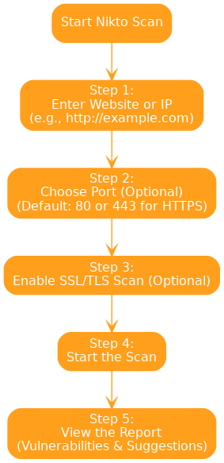
Flowchart

Slide 5
Process
Step 1: Enter Target Website or IP • Type in the web address or IP of the site you want to scan.
Example: http://xyz.com or 192.168.1.100
Step 2: Choose Port (Optional) • Nikto will scan port 80 (HTTP) by default, but if needed you can specify an alternative port.
Example: 443 for HTTPS.
Step 3: Set SSL Option (Optional) • If the site is accessed via HTTPS, you can use the SSL/TLS scan option to detect problems with it.
Step 4: Start the Scan • Click Start to run the Nikto scan on the target. The tool will begin checking for known web vulnerabilities.
Click on the model to interact

Slide 6
2. Relation between Earth, Sun, and Moon
Step 5: View the Report
• After the scan, you will see a report with all discovered issues, including security risks and recommendations for fixing them.
Let's look at an example Command (Nikto CLI)::
• nikto -h http://192.168.1.100 -p 80
Now lets breakdown the command:-
• -h: Target host (website or IP)
• -p 80: Port number (80 is the default for HTTP)
If scanning HTTPS:
nikto -h https://192.168.1.100 -p 443

